Slide 1
AI IN EDUCATION
SlideMake.com

Slide 2
Introduction to AI in Education
Artificial Intelligence (AI) is transforming the educational landscape by offering innovative solutions.
AI technologies can personalize learning experiences based on individual student needs.
The integration of AI in education aims to enhance engagement, efficiency, and learning outcomes.
Notes:
Image source: https://scanlibs.com

Slide 3

Types of AI Technologies in Education
Adaptive learning systems adjust content according to student performance and preferences.
Intelligent tutoring systems provide personalized feedback and support for learners.
AI-powered chatbots assist students and teachers by answering questions and providing resources.
Notes:
Image source: https://talkpal.ai

Slide 4
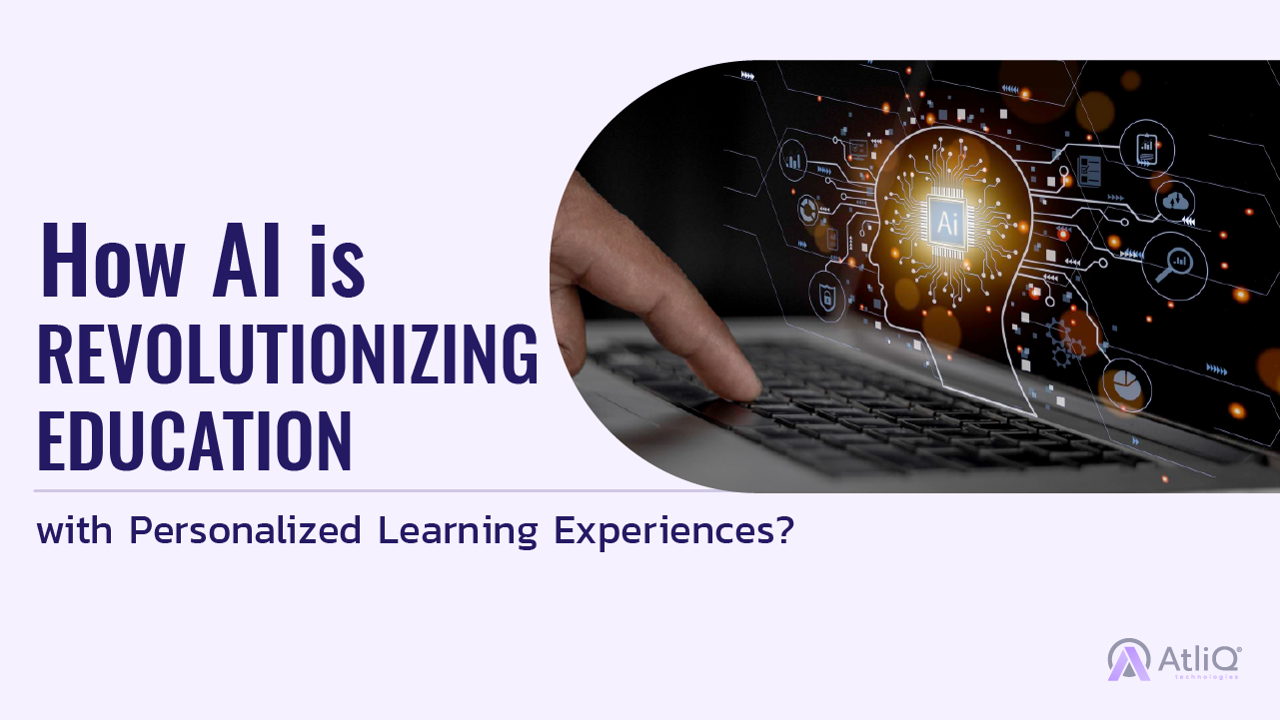
Benefits of AI in Education
AI enables personalized learning, catering to diverse student abilities and learning styles.
It automates administrative tasks, allowing educators to focus more on teaching and mentorship.
AI-driven analytics help identify at-risk students early and tailor interventions effectively.
Notes:
Image source: https://www.atliq.ai

Slide 5
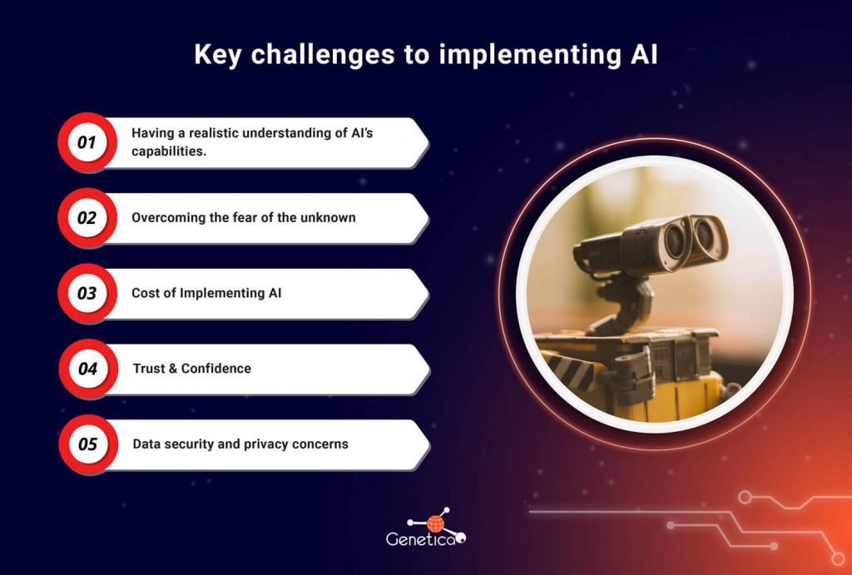
Challenges and Concerns
Data privacy and security are major concerns when implementing AI tools in educational settings.
There is a risk of increased dependency on technology, potentially affecting critical thinking skills.
Ensuring equitable access to AI resources remains a challenge across different regions and socioeconomic groups.
Notes:
Image source: https://genetica.ai

Slide 6

AI and Teacher Support
AI can assist teachers in designing curriculum and assessing student progress more efficiently.
It provides real-time insights into student performance, enabling timely interventions.
AI tools can help reduce workload and reduce burnout among educators.
Notes:
Image source: https://www.aiforteachers.ai

Slide 7
Ethical Considerations
Transparency in AI algorithms is essential to maintain trust and fairness in educational decisions.
Bias in AI systems can lead to unfair treatment of certain student groups.
Ethical use of AI requires ongoing monitoring and regulation to prevent misuse and discrimination.
Notes:
Image source: https://i1.rgstatic.net

Slide 8
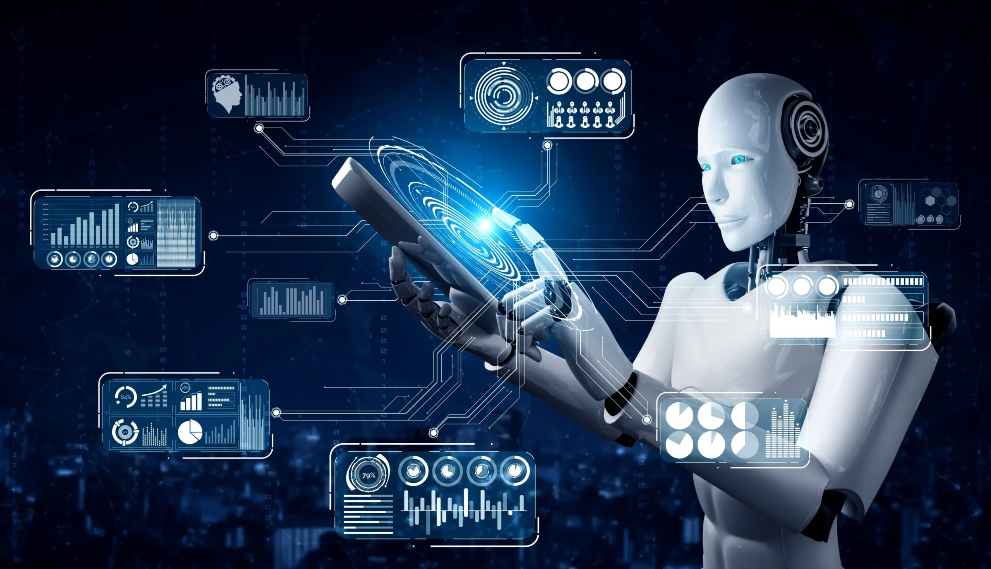
Future Trends in AI and Education
Continued advancements will lead to more sophisticated and intuitive AI learning environments.
Virtual and augmented reality powered by AI could create immersive educational experiences.
Collaboration between educators, AI developers, and policymakers is vital to shape effective solutions.
Notes:
Image source: https://octavius.ai

Slide 9

Case Studies and Success Stories
Several schools have successfully implemented AI to improve personalized learning pathways.
AI-driven platforms have shown positive impacts on student engagement and academic achievement.
Pilot programs demonstrate the potential of AI to support inclusive education for students with special needs.
Notes:
Image source: https://ai47labs.com

Slide 10

Conclusion and Next Steps
AI has the potential to revolutionize education by making learning more personalized and accessible.
Addressing challenges and ethical concerns is crucial for responsible AI integration.
Ongoing research, collaboration, and innovation will shape the future of AI in education.
Notes:
Image source: https://mylearnomics.com

